Slide 1
PROTEIN SYNTHESIS
TRANSCRIPTION AND TRANSLATION

Slide 2
INTRODUCTION
The process in which cells make proteins is called protein synthesis
It actually consists of two processes: transcription and translation
Transcription is a process of using DNA as a template to make an RNA molecule and takes place in the nucleus
RNA then leaves the nucleus and goes to a ribosome in the cytoplasm, where translation occurs
Translation reads the genetic code in mRNA and makes a protein

Slide 3
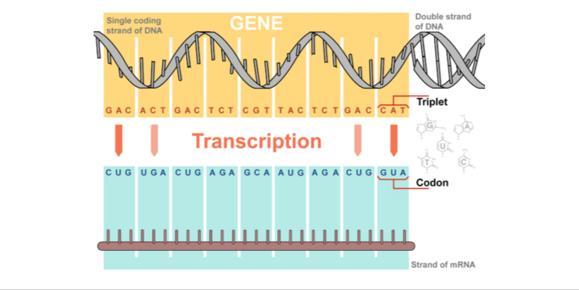
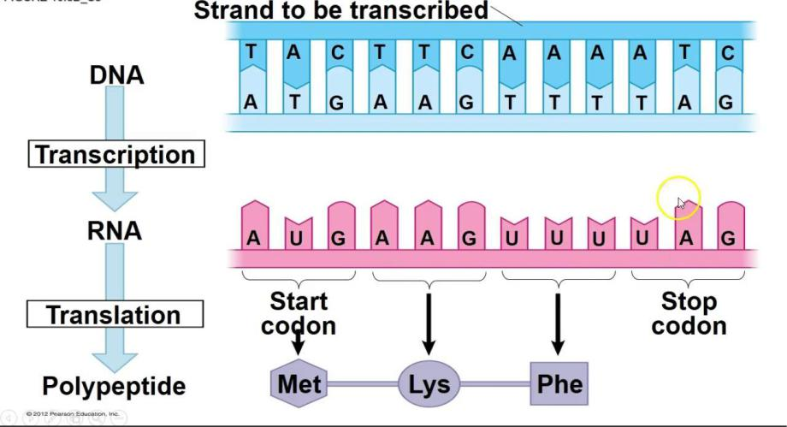
Overview of Transcription
Transcription uses the sequence of bases in a strand of DNA to make a complementary strand of mRNA.
Triplets are groups of three successive nucleotide bases in DNA.
Codons are complementary groups of bases in mRNA

Slide 4
Steps of Transcription
Transcription takes place in three steps: initiation, elongation, and termination.
Initiation is the beginning of transcription. It occurs when the enzyme RNA polymerase binds to a region of a gene called the promoter.
This signals the DNA to unwind so the enzyme can ‘‘read’’ the bases in one of the DNA strands.
The enzyme is now ready to make a strand of mRNA with a complementary sequence of bases

Slide 5
Cont.
Elongation is the addition of nucleotides to the mRNA strand
RNA polymerase reads the unwound DNA strand and builds the mRNA molecule, using complementary base pairs
During this process, when newly formed RNA is bound to the unwound DNA.
The adenine (A) in the DNA binds to a uracil (U) in the RNA.
Termination is the ending of transcription, and occurs when RNA polymerase crosses a stop (termination) sequence in the gene. The mRNA strand is complete, and it detaches from DNA

Slide 6
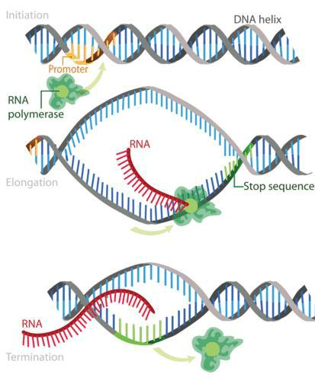
Steps of Transcription

Slide 7
PRE- mRNA SPLICING
The molecule which is formed by transcription in one of your cells is called a pre-mRNA, it will undergo steps to become an actual messenger RNA (mRNA)
These are:
Addition of a 5' cap to the beginning of the RNA
Addition of a poly-A tail (tail of A nucleotides) to the end of the RNA
Chopping out of introns, or "junk" sequences, and pasting together of the remaining, good sequences (exons)
Once it's completed these steps, the RNA is a mature mRNA. It can travel out of the nucleus and be used to make a protein.

Slide 8
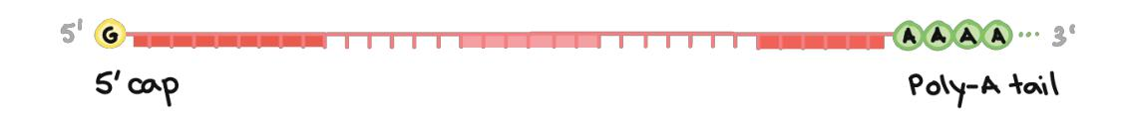
5' CAP AND POLY-A TAIL
Both ends of a pre-mRNA are modified by the addition of chemical groups
The group at the beginning (5' end) is called a cap, while the group at the end (3' end) is called a tail
Both the cap and the tail protect the transcript and help it get exported from the nucleus and translated on the ribosomes found in the cytosol
The 5’ cap is added to the first nucleotide in the transcript during transcription.
The cap is a modified guanine (G) nucleotide, and it protects the transcript from being broken down.
It also helps the ribosome attach to the mRNA and start reading it to make a protein.

Slide 9
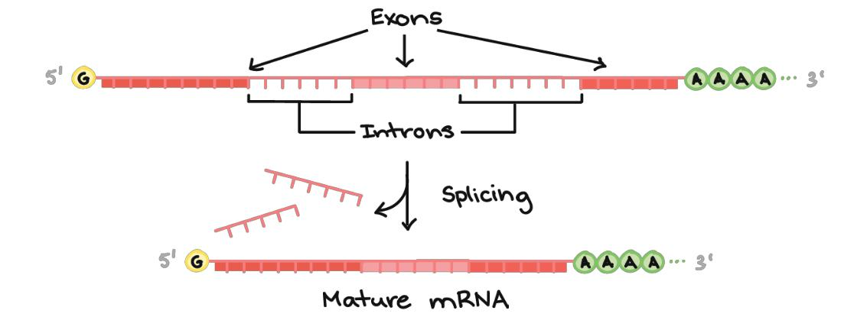
RNA splicing
In RNA splicing, specific parts of the pre-mRNA, called introns are recognized and removed by a protein-and-RNA complex called the spliceosome
Introns are considered as "junk" sequences that must be cut out so the "good parts" of the RNA molecule can be assembled
The pieces of the RNA that are not chopped out are considered to be ‘good parts’ called exons
The exons are pasted together by the spliceosome to make the final, mature mRNA that is taken out of the nucleus.

Slide 10
Translation
Translation is a process by which the genetic code contained within an mRNA molecule is decoded to produce the specific sequence of amino acids in a polypeptide chain.
It occurs in the cytoplasm following transcription and, like transcription, has three stages:
Initiation, elongation and termination.
Components of Translation
The key components required for translation are mRNA, ribosomes, tRNA and aminoacyl-tRNA synthetases.
During translation, mRNA nucleotide bases are read as three base codons, each of which codes for a particular amino acid.

Slide 11
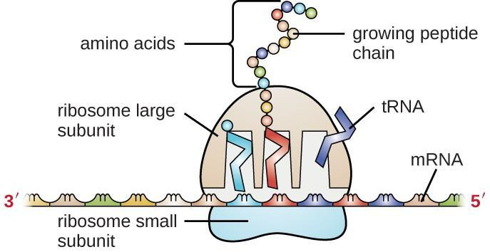
The genetic code is described as degenerate because a single amino acid may be coded for by more than one codon. There are also specific codons that signal the start and the end of translation.
Each tRNA molecule possesses an anticodon on the opposite end that is complementary to the mRNA codon.
tRNA molecules are therefore responsible for bringing amino acids to the ribosome in the correct order ready for polypeptide assembly.
Aminoacyl-tRNA synthetases are enzymes that link amino acids to their corresponding tRNA molecules. The resulting complex is charged and is referred to as an aminoacyl-tRNA.

Slide 12
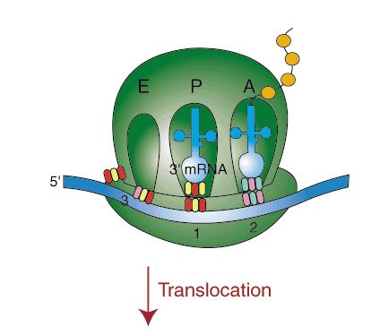
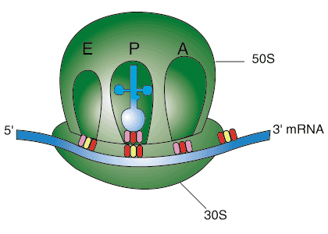
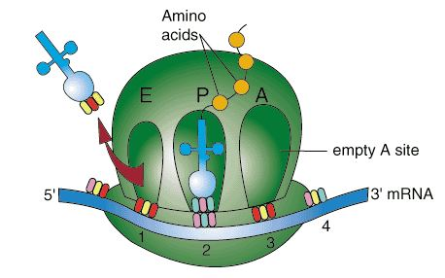
STEPS INVOLVED IN TRANSLATION

Slide 13
Initiation
At the 5’ cap of mRNA the small 50s subunit of the ribosome (with methionyl-tRNA) binds.
For translation to start, the start codon 5’AUG must be recognised.
This is a codon specific to the amino acid methionine (anticodon on tRNA=5’CAU). The large 60s subunit of the ribosome then binds for elongation to occur.
The ribosome has two tRNA binding sites; the P site which holds the peptide chain and the A site which accepts the tRNA.

Slide 14
Elongation
Met-tRNA occupies the P site, another aminoacyl-tRNA with an anticodon complementary to the next codon comes to occupy the A site and it requires GTP
The enzyme peptidyl-transferase forms a peptide bond between methionine and the next aminoacyl-tRNA
The tRNA molecule in the P site becomes uncharged and leaves the ribosome
The ribosome then translocates along the mRNA molecule to the next codon
This opens up the A site for the next aminoacyl-tRNA. The polypeptide chain is built up in the direction from the N terminal to the C terminal

Slide 15
Termination
One of the three stop codons ((UAA, UAG, or UGA)enters the A site.
No tRNA molecules bind to these codons so the peptide and tRNA in the P site become hydrolysed releasing the polypeptide into the cytoplasm.
The small and large subunits of the ribosome dissociate ready for the next round of translation.
The polypeptide produced undergoes post-translational modification before becoming the fully active protein.

Slide 16
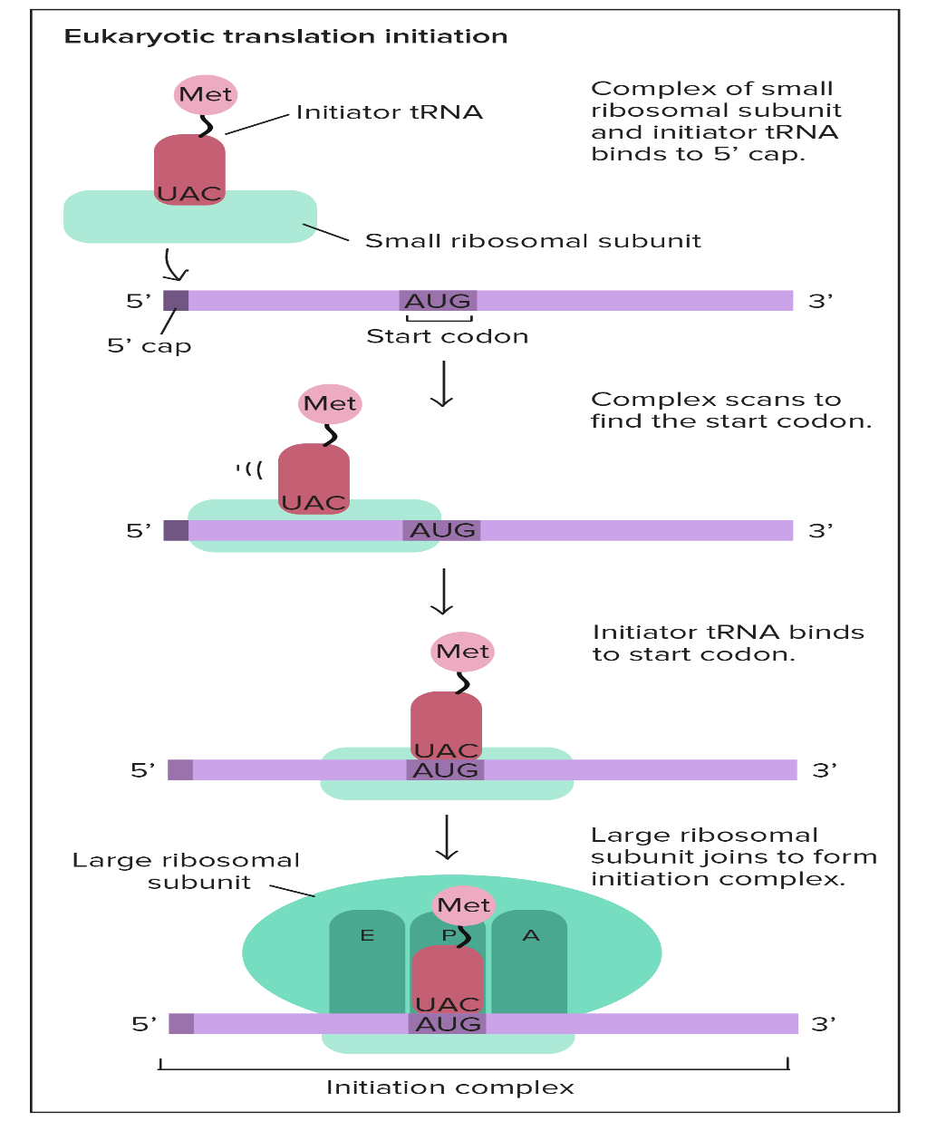
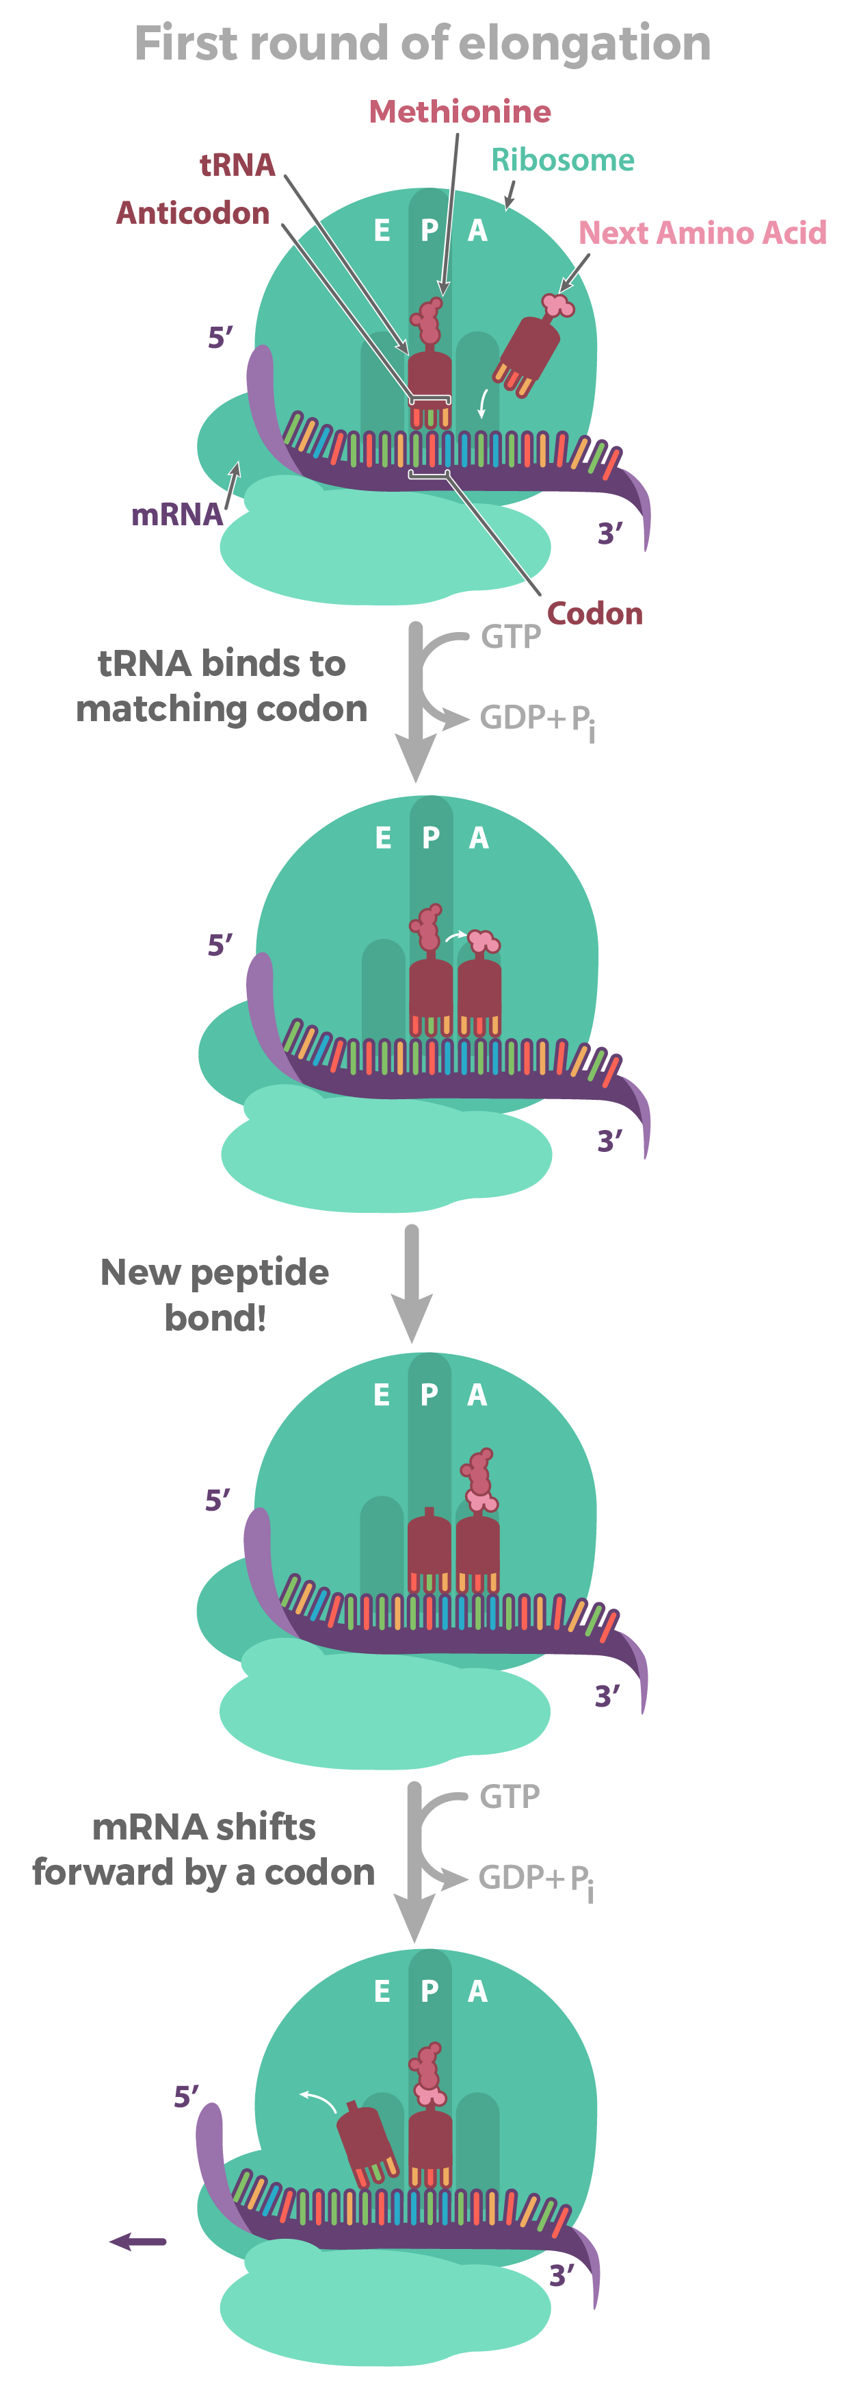

Slide 17
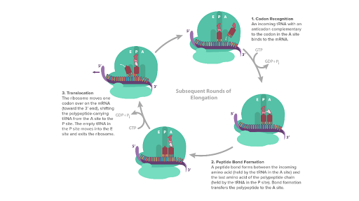

Slide 18
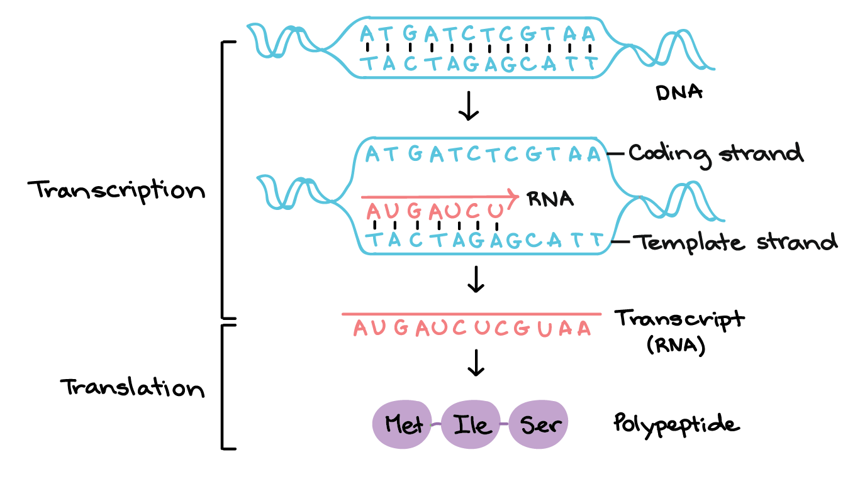
OVERALL PROCESS OF TRANSCRIPTION & TRANSLATION

Slide 19
THANK YOU

